Slide 1
Object detection

Slide 2
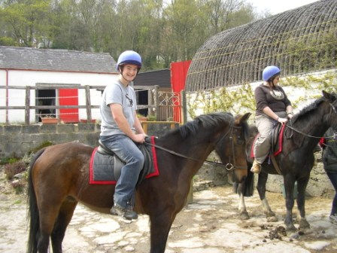
The Task
person 1
person 2
horse 1
horse 2

Slide 3
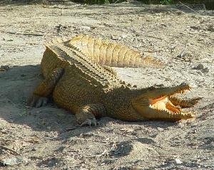
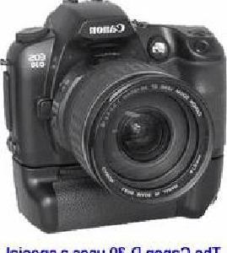
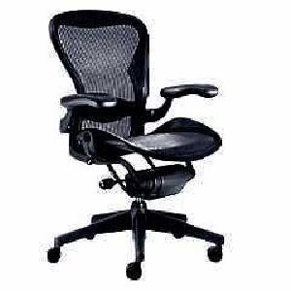
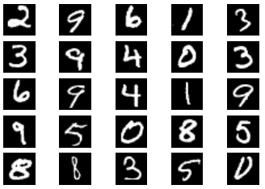
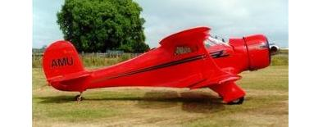
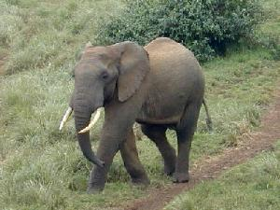
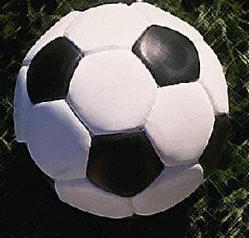

Image classification
$K$ classes
Task: assign correct class label to the whole image
Digit classification (MNIST)
Object recognition (Caltech-101)

Slide 4
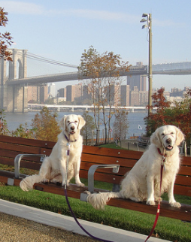
Classification vs. Detection
Dog
Dog
Dog

Slide 5
Problem formulation
{ airplane, bird, motorbike, person, sofa }
person
motorbike
Input
Desired output

Slide 6
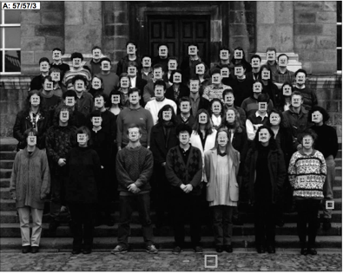
Datasets
Face detection
One category: face
Frontal faces
Fairly rigid, unoccluded
1990’s
Human Face Detection in Visual Scenes. H. Rowley, S. Baluja, T. Kanade. 1995.

Slide 7
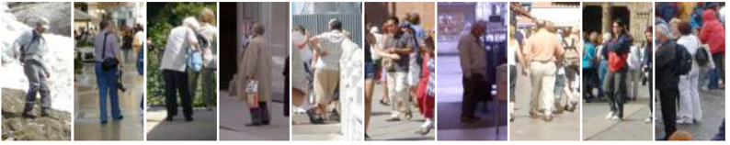
Pedestrians
One category: pedestrians
Slight pose variations and small distortions
Partial occlusions
Faces
1990’s
2000’s
Histograms of Oriented Gradients for Human Detection. N. Dalal and B. Triggs. CVPR 2005

Slide 8
PASCAL VOC
20 categories
10K images
Large pose variations, heavy occlusions
Generic scenes
Cleaned up performance metric: IoU, Average Precision (AP), mean AP
Faces
1990’s
2000’s
2007 - 2012

Slide 9
Coco
80 diverse categories
100K images
Heavy occlusions, many objects per image, large scale variations
Faces
1990’s
2000’s
2007 - 2012
2014 -

Slide 10

Evaluation metric

Slide 11
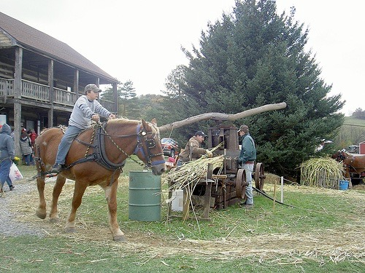
Evaluating a detector
Test image (previously unseen)

Slide 12
First detection ...
Confidence
0.9
‘person’ detector predictions

Slide 13
Second detection ...
0.9
0.6
‘person’ detector predictions

Slide 14
Third detection ...
0.2
0.9
0.6
‘person’ detector predictions

Slide 15
Compare to ground truth
0.2
0.9
0.6
‘person’ detector predictions
ground truth ‘person’ boxes

Slide 16
Intersection over Union (IoU)
Intersection over Union (IoU) is a popular metric used to evaluate the accuracy of an object detector on a particular dataset.
IoU measures the overlap between two bounding boxes:
the predicted bounding box from the object detection algorithm and
the ground truth bounding box provided by the dataset.
It helps determine how well the predicted bounding box matches the ground truth.

Slide 17

How IoU is Calculated?
Intersection: This is the area of overlap between the predicted bounding box and the ground truth bounding box.
Union: This is the area covered by both the predicted bounding box and the ground truth bounding box.
The formula for IoU is:

Slide 18
Matching detections to ground truth

Slide 19
Example: Computing IoU
Let’s consider 2 hypothetical bounding boxes (ground truth + bounding box), and compute IoU between them.
We will generate different predictions and see how IoU values change.

Slide 20
Example: draw bounding boxes
sdf
import numpy as np
import matplotlib.pyplot as plt
# Create an 11x11 grid initialized to zero
image = np.zeros((11, 11))
# Define the first object (4x4)
object1_top_left = (3, 3)
object1_bottom_right = (7, 7) # (0+4-1, 0+4-1)
# Define the second object (3x3)
object2_top_left = (6, 6)
object2_bottom_right = (8, 8) # (6+3-1, 6+3-1)
# Place the objects in the grid
image[object1_top_left[0]:object1_bottom_right[0]+1, object1_top_left[1]:object1_bottom_right[1]+1] = 1
image[object2_top_left[0]:object2_bottom_right[0]+1, object2_top_left[1]:object2_bottom_right[1]+1] = 2
# Show the grid
plt.figure(figsize=(5,5))
plt.imshow(image, cmap='hot', interpolation='nearest')
plt.colorbar()
plt.show()

Slide 21
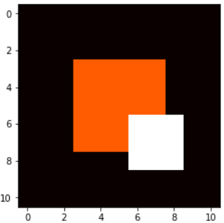
Bounding boxes preview

Slide 22
Example: Compute IoU
sdf
def calculate_iou(box1, box2):
# Extract coordinates
x1_min, y1_min, x1_max, y1_max = box1
x2_min, y2_min, x2_max, y2_max = box2
# Calculate intersection coordinates
inter_x_min = max(x1_min, x2_min)
inter_y_min = max(y1_min, y2_min)
inter_x_max = min(x1_max, x2_max)
inter_y_max = min(y1_max, y2_max)
# Calculate intersection area
if inter_x_max > inter_x_min and inter_y_max > inter_y_min:
inter_area = (inter_x_max - inter_x_min + 1) * (inter_y_max - inter_y_min + 1)
else:
inter_area = 0
# Calculate union area
area1 = (x1_max - x1_min + 1) * (y1_max - y1_min + 1)
area2 = (x2_max - x2_min + 1) * (y2_max - y2_min + 1)
union_area = area1 + area2 - inter_area
# Calculate IoU
iou = inter_area / union_area if union_area != 0 else 0
return iou
# Define bounding boxes based on the above settings
bbox1 = [6, 6, 8, 8] # (xmin, ymin, xmax, ymax)
bbox2 = [6, 6, 8, 8]
# Compute IoU
iou = calculate_iou(bbox1, bbox2)
print("Intersection over Union (IoU) is:", iou)

Slide 23
Calculating IoU
bbox1 = [3, 3, 7, 7] # (xmin, ymin, xmax, ymax)
bbox2 = [6, 6, 8, 8]
IoU: 0.133

Slide 24
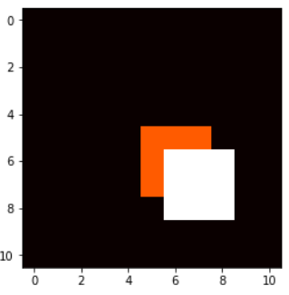
Calculating IoU
bbox1 = [5, 5, 7, 7] # (xmin, ymin, xmax, ymax)
bbox2 = [6, 6, 8, 8]
IoU: 0.285

Slide 25
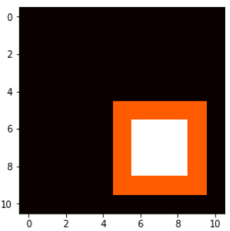
Calculating IoU
bbox1 = [5, 5, 9, 9] # (xmin, ymin, xmax, ymax)
bbox2 = [6, 6, 8, 8]
IoU: 0.36

Slide 26
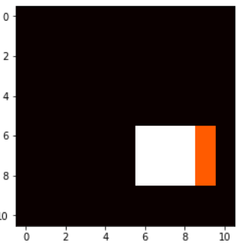
Calculating IoU
bbox1 = [6, 6, 8, 9] # (xmin, ymin, xmax, ymax)
bbox2 = [6, 6, 8, 8]
IoU: 0.75

Slide 27
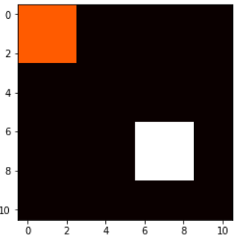
Calculating IoU
bbox1 = [0, 0, 2, 2] # (xmin, ymin, xmax, ymax)
bbox2 = [6, 6, 8, 8]
IoU: 0.0 # no overlap at all

Slide 28
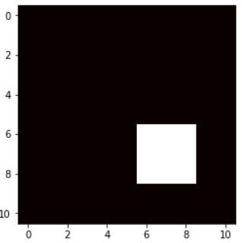
Calculating IoU
bbox1 = [6, 6, 8, 8] # (xmin, ymin, xmax, ymax)
bbox2 = [6, 6, 8, 8]
IoU: 1.0 # 100% overlap

Slide 29
Matching detections to ground truth
Match detection to most similar ground truth
highest IoU
If IoU > 50%, mark as correct
If multiple detections map to the same ground truth, mark only one (with the highest IoU) as correct.

Slide 30
Evaluation Metrics
Evaluation of an object detection models involves the following evaluation metrics:
TP, FP, TN
Precision
Recall
Confidence score
IoU
Average Precision (AP)
Mean Average Precision (mAP)

Slide 31
Evaluation Metrics (Contd.)
A nice tutorial with hands on worked example:
https://zihaogeng.medium.com/how-to-evaluate-an-object-detection-model-iou-precision-recall-and-map-f7cc12e0dcf6
Note: Rest of the lecture was delivered based on the above tutorial, so read it MUST for understanding different evaluation metrics such as confidence, IoU, Precision, Recall, mAP etc.

